Slide 1
Access 2016 Module 4
Using Reports

Slide 2
Module Objectives
Use the Report Wizard
Use Report Layout View
Review report sections
Apply group and sort orders
Add subtotals and counts
Resize and align controls
Format a report
Create mailing labels

Slide 3
Use the Report Wizard (Slide 1 of 2)
A report is the primary object you use to print database content
Report Wizard is one way to create a report
Tool that asks questions to guide development of the report
Responses determine record source, style and layout
Record source is the table or query that defines the fields and records displayed on the report

Slide 4
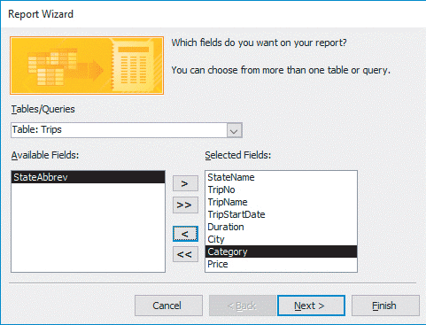
Use the Report Wizard (Slide 2 of 2)
Selecting fields for a report using the Report Wizard

Slide 5
Use Report Layout View (Slide 1 of 3)
Reports have multiple views that you use for various report-building and report-viewing activities
Report Layout View applies a grid to the report that helps you resize, move, and position controls

Slide 6
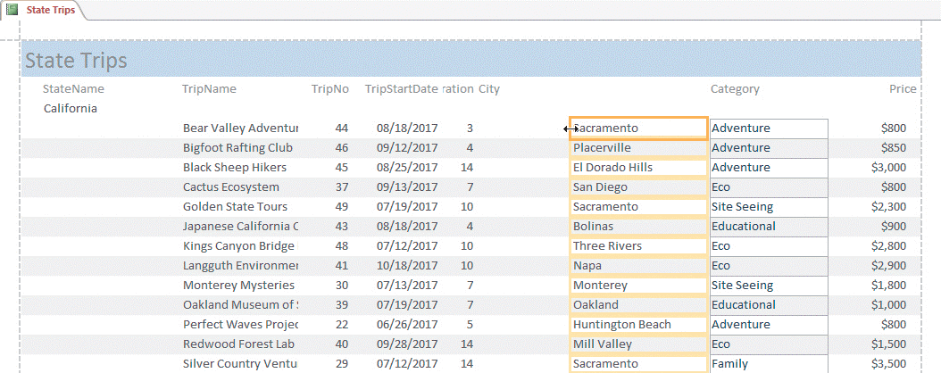
Use Report Layout View (Slide 2 of 3)
Modifying column width in Report Layout View

Slide 7
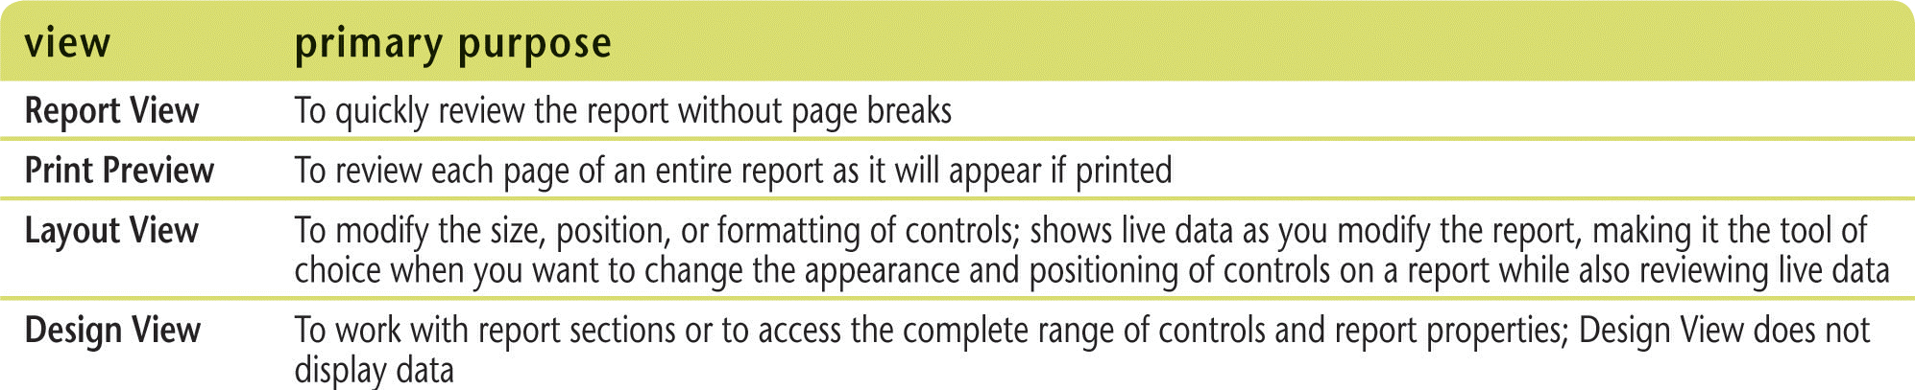
Use Report Layout View (Slide 3 of 3)
Report views

Slide 8
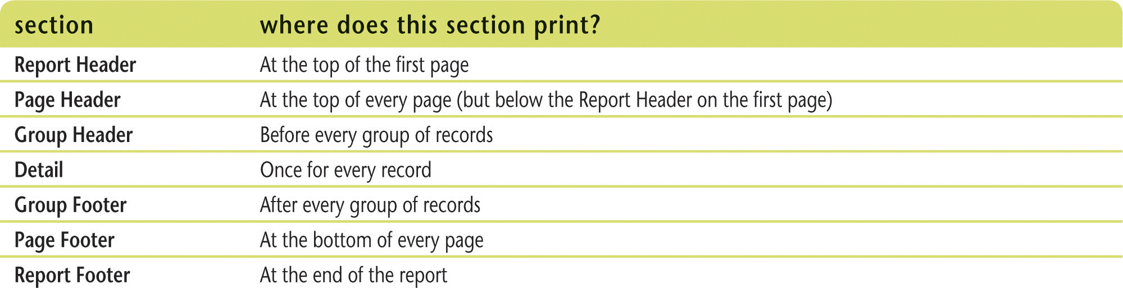
Review Report Sections (Slide 1 of 2)
Report sections determine where and how often controls in that section print in the final report

Slide 9
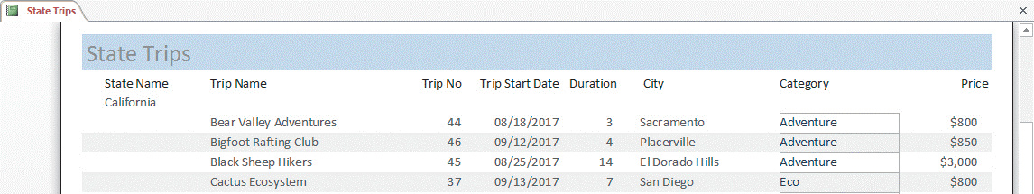
Review Report Sections (Slide 2 of 2)
Report in Design View showing sections

Slide 10
Apply Group and Sort Orders (Slide 1 of 2)
Grouping means to sort records by a particular field plus provide a header and/or footer section before or after each group of sorted records
To change sorting or grouping options for a report, you must work in Report Design View
Record Source property of a report or form determines what fields and records the report or form will display

Slide 11
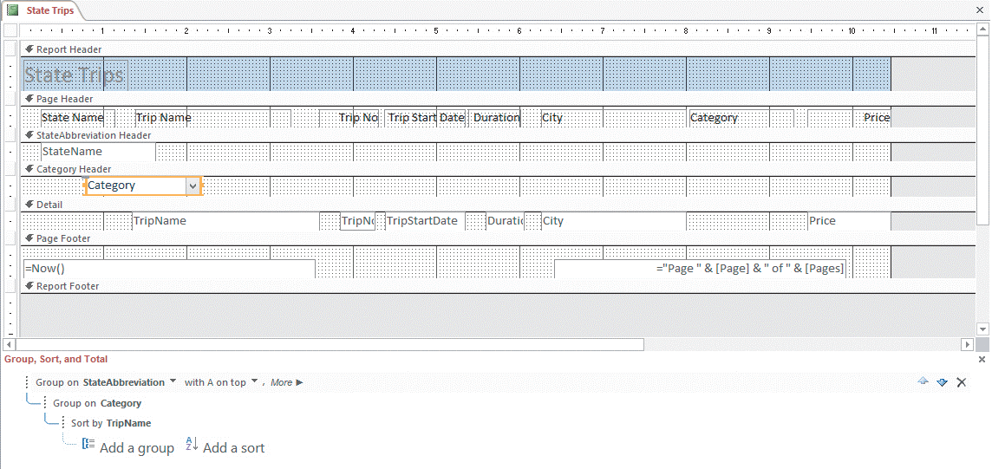
Apply Group and Sort Orders (Slide 2 of 2)
Group, Sort, and Total pane with new group heading

Slide 12
Add Subtotals and Counts (Slide 1 of 2)
Calculations are used to add subtotals and counts to a report
Expressions are needed to create a calculation
Functions are built-in Access formulas
Arguments are information needed by a function

Slide 13
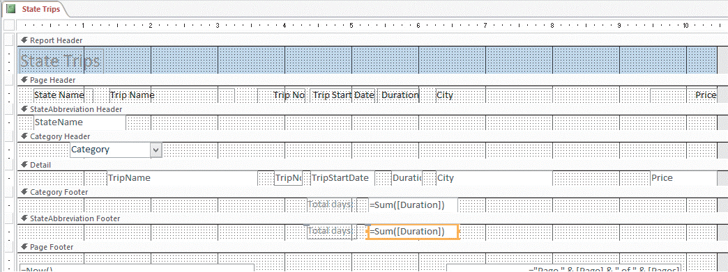
Add Subtotals and Counts (Slide 2 of 2)
Adding subtotals to group footer sections

Slide 14
Resize and Align Controls (Slide 1 of 3)
Two alignment commands:
Within its own border
With respect to each other
You can resize a control by using the ↔ pointer
[Ctrl] + arrow key(s) move a control one pixel at a time
[Shift] + arrow key(s) resize a control one pixel at a time

Slide 15
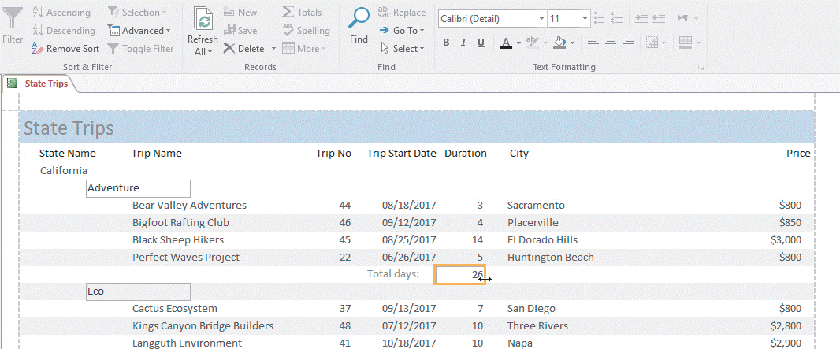
Resize and Align Controls (Slide 2 of 3)
Resizing controls in Layout View

Slide 16
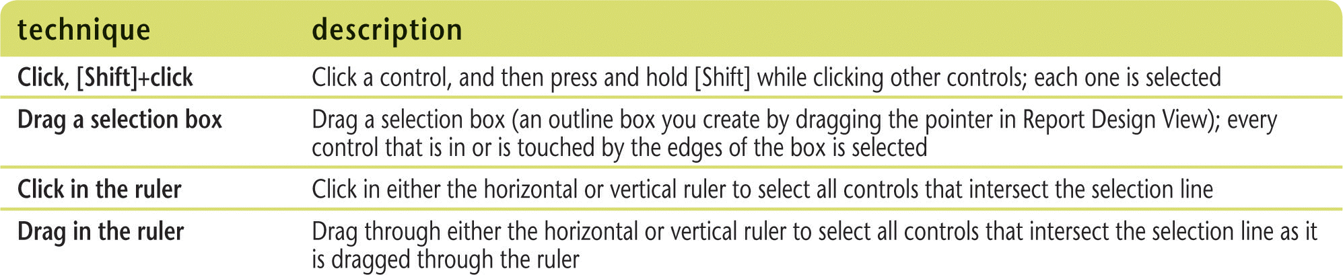
Resize and Align Controls (Slide 3 of 3)
Selecting more than one control at a time in Report Design View

Slide 17
Format a Report (Slide 1 of 2)
Formatting refers to enhancing the appearance of the information
Formatting includes
Font style, size and color
Background color
Line thickness and color
Alignment

Slide 18
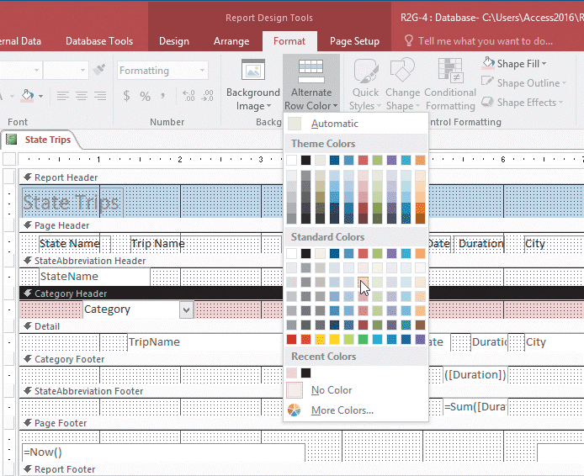
Format a Report (Slide 2 of 2)
Formatting section backgrounds

Slide 19
Create Mailing Labels (Slide 1 of 2)
Any data in your Access database can be converted into labels using the Label Wizard, a special report wizard that precisely positions and sizes information for hundreds of standard business labels

Slide 20
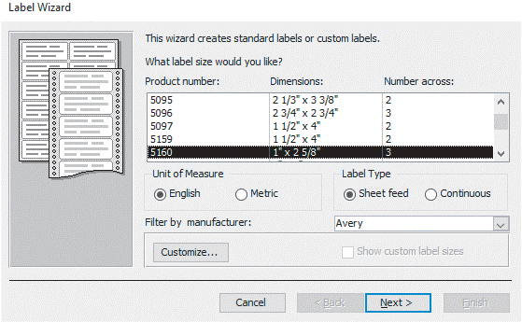
Create Mailing Labels (Slide 2 of 2)
Label Wizard dialog box

